Slide 1
Religion, PID, and Attitudes towards the LGBTQ+ Community
DS 5610 – Fall 2023
Eleanor Beers

Slide 2
Motivations: Prior Research
Long established relationship between religious affiliation and public opinion towards the LGBTQ+ community (Olson et. al 2006)
Due in part to religious texts and conservative interpretations of the texts
Underlies conservative “traditional values” and “moral values” that are extremely influential in American politics
Decline of Christianity, increased support for LGBTQ+ rights (Pew Research Center 2019) (Migdon 2022)
Questions:
How have attitudes towards the LGBTQ+ community changed over time for religious and non-religious populations?
How has religious affiliation changed over time? By party ID?

Slide 3
Dataset: ANES (Time Series)
American National Election Studies (ANES)
Survey conducted every presidential election year measuring public opinion on a variety of topics
Collaboration between Duke University, University of Michigan, The University of Texas at Austin, and Stanford University
Funded by the National Science Foundation.
A complete dataset of variables consistent across all versions of the survey, beginning in 1948
My variables first appeared in the 1984 study
Variables
Feeling thermometer: Attitudes towards LGBTQ+ community (measured on 0-100 scale; 0 being extremely cold feelings, 100 being warmest feelings)
Party ID (self-identified)
Religious affiliation (is religion a major part of respondent’s life), measured categorically (1: important, 0: not important)
Year: Year that study was conducted

Slide 4
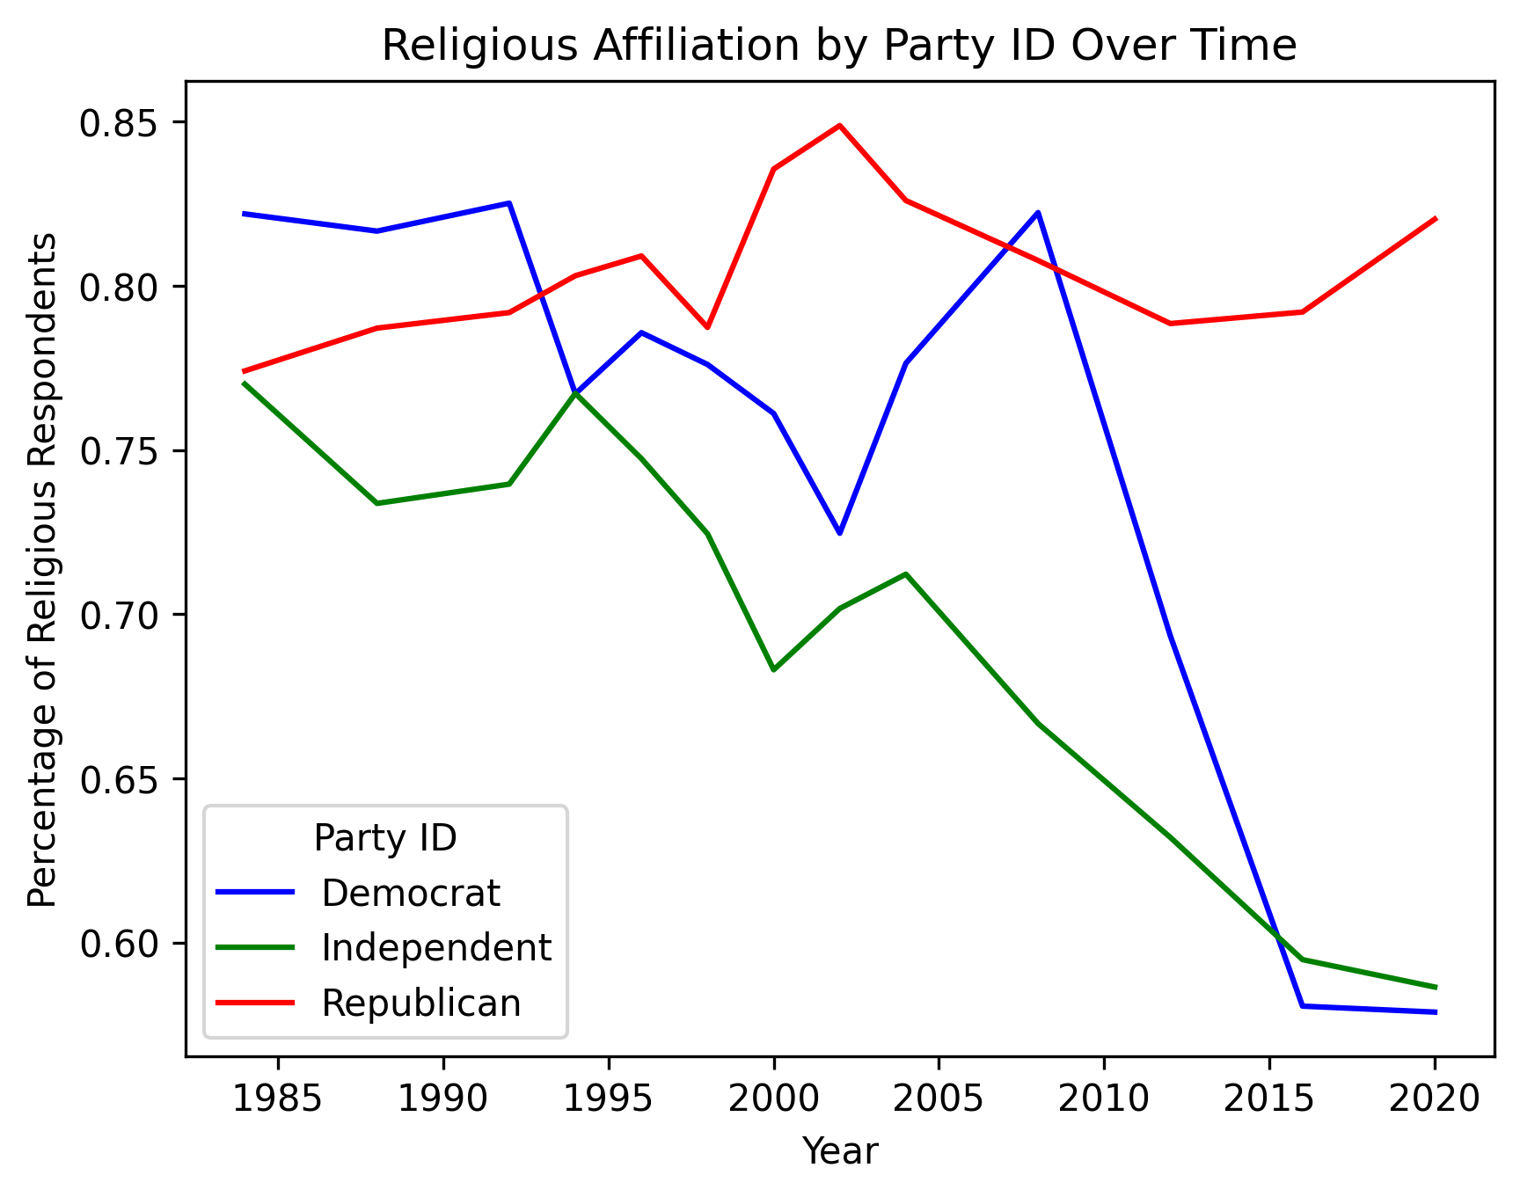
Analysis: Religious affiliation over time (by PID)

Slide 5
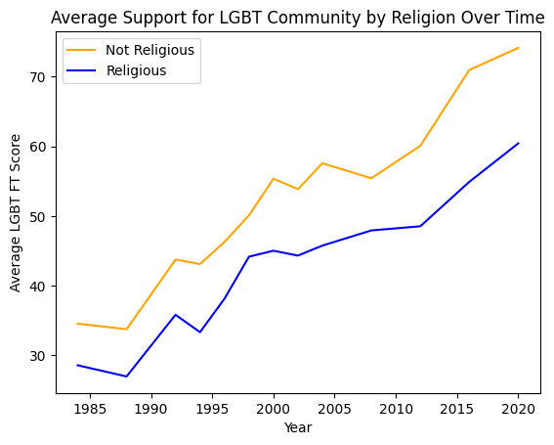
Analysis: Attitudes towards LGBTQ+ people by religious affiliation

Slide 6
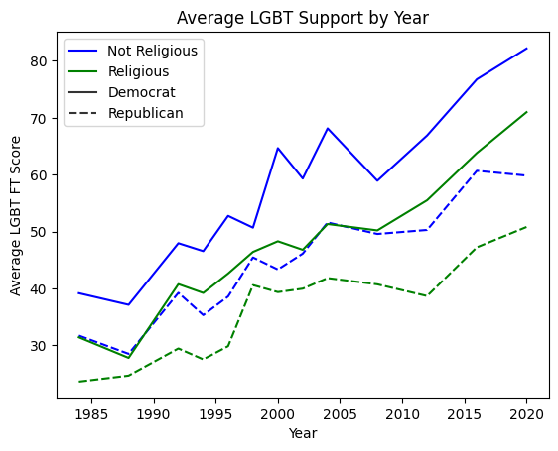
Analysis: Attitudes towards LGBTQ+ community by PID and religious affiliation

Slide 7
Takeaways: Consistency and Patterns
Decline in religious affiliation over time; pronounced amongst Democrats and Independents
Increase in “warmer” attitudes towards the LGBTQ+ community over time amongst religious and non-religious populations, though non-religious population has had consistently warmer attitudes on average
Consistent across Party ID as well (i.e., non-religious Democrats more tolerant than religious Democrats and non-religious Republicans more tolerant than religious Republicans)

Slide 8
References
American National Election Studies. 2021. ANES 2020 Time Series Study Full Release [Time Series Cumulative Data File]. September 16, 2022 version. www.electionstudies.org
Migdon, B. (2023, June 30). Support for LGBTQ+ rights on the rise: Poll. The Hill. https://thehill.com/changing-america/respect/equality/599240-support-for-lgbtq-rights-on-the-rise-poll/
Olson, L. R., Cadge, W., & Harrison, J. T. (2006). Religion and Public Opinion about Same‐Sex Marriage *. Social Science Quarterly., 87(2), 340–360. https://doi.org/10.1111/j.1540-6237.2006.00384.x
Pew Research Center. (2019, October 17). In U.S., decline of Christianity continues at Rapid Pace. Pew Research Center’s Religion &amp; Public Life Project. https://www.pewresearch.org/religion/2019/10/17/in-u-s-decline-of-christianity-continues-at-rapid-pace/

